Slide 1





A-RAY
Accumulated Report Analysis of Youth
Presented By:
​
Miss Aditi Agwan – GEC Nagpur (BE CSE)​
Miss Alefiya Sanawadwala – GEC Nagpur (BE CSE)​​
Miss Riddhi Jayant Hedaoo – GEC Nagpur (BE CSE)​
© Edunet Foundation. All rights reserved.

Slide 2


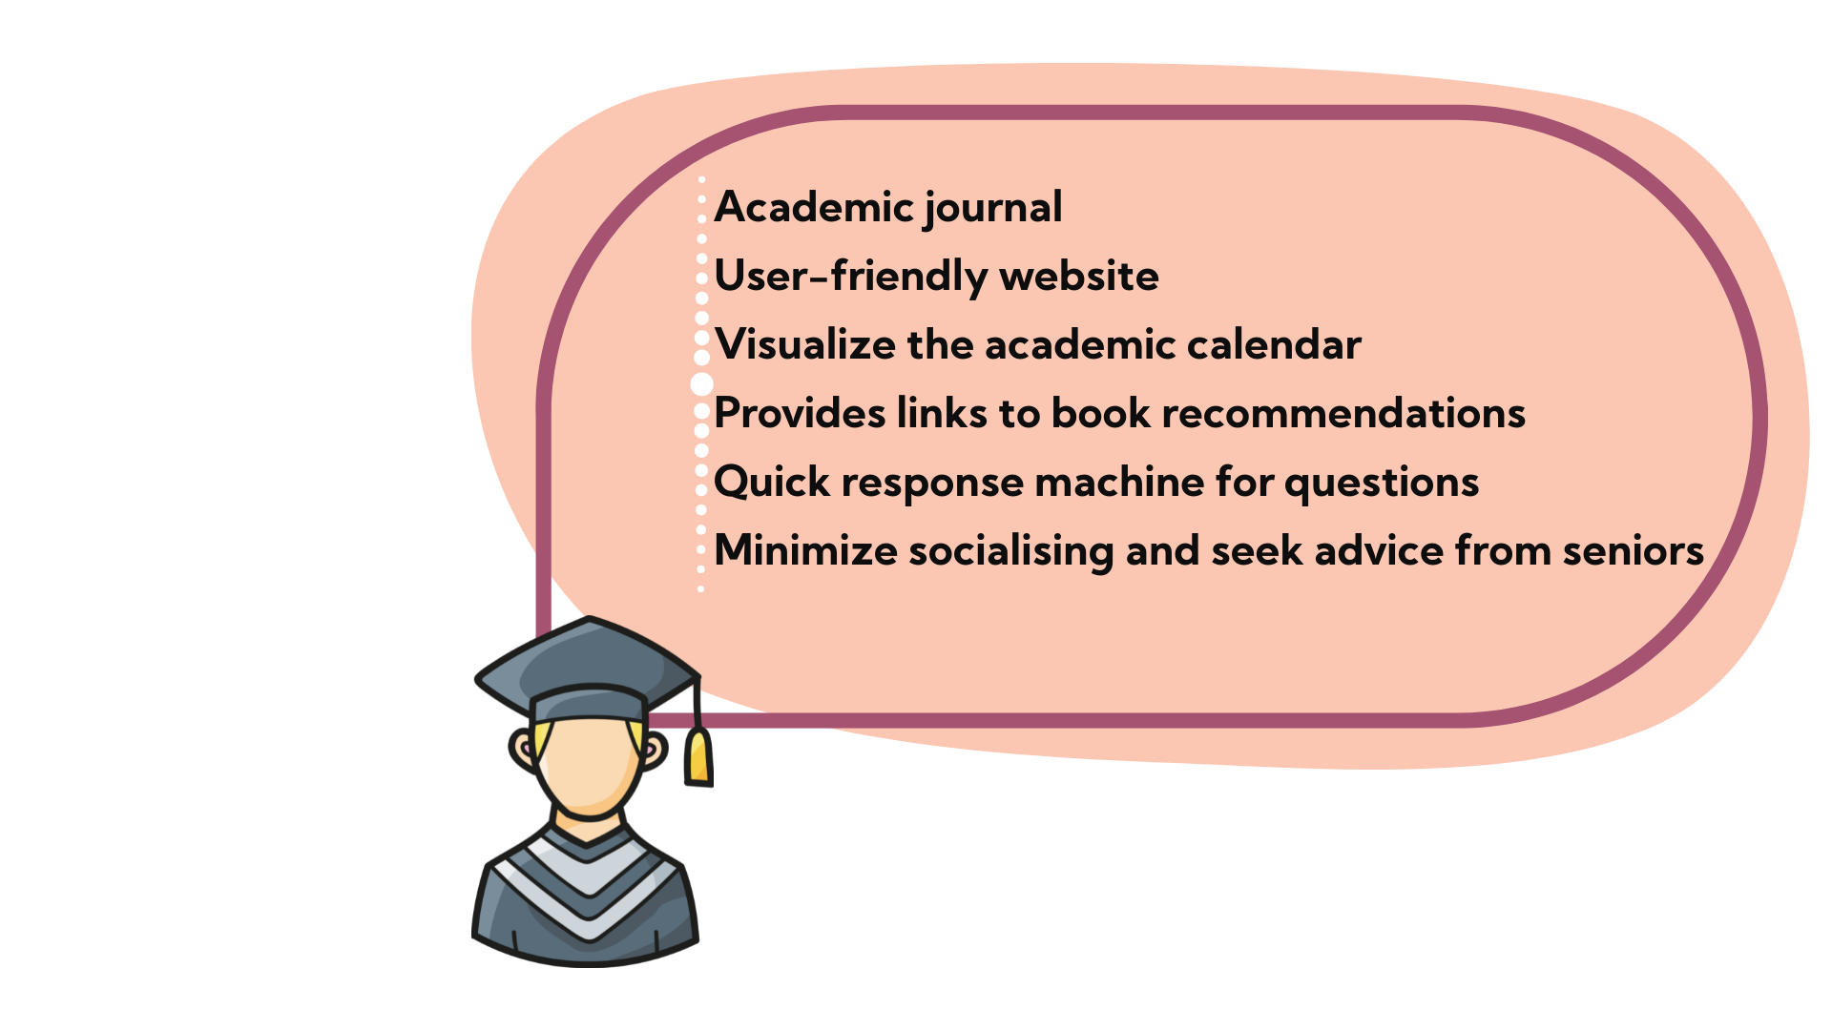
STAKEHOLDER
Stakeholder - Engineering Students

Slide 3







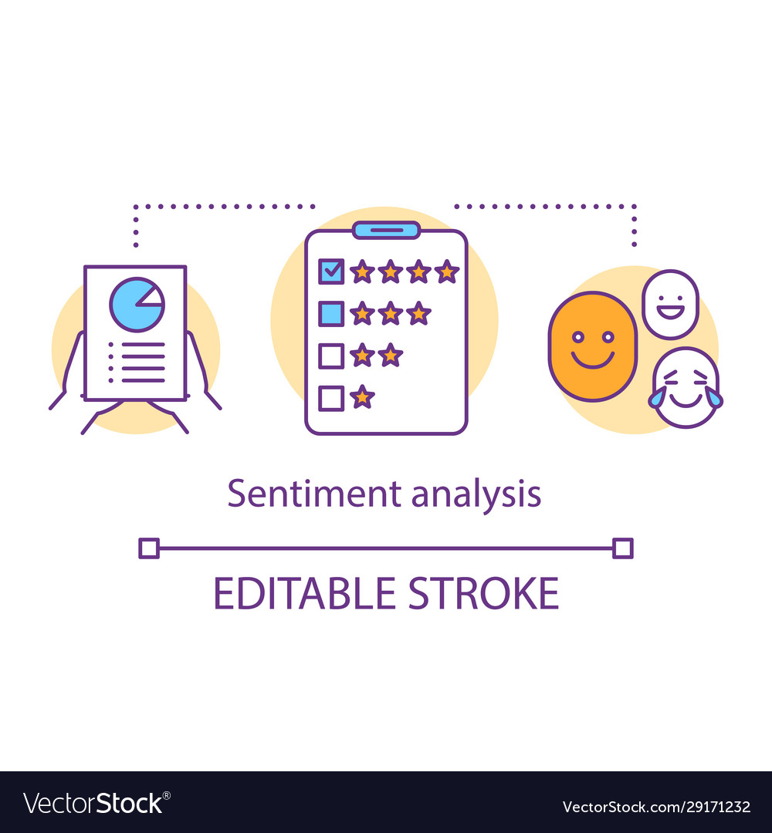


SYSTEM DESIGN
Database
Admin Dashboard
Web App
Student Dashboard
User

Slide 4
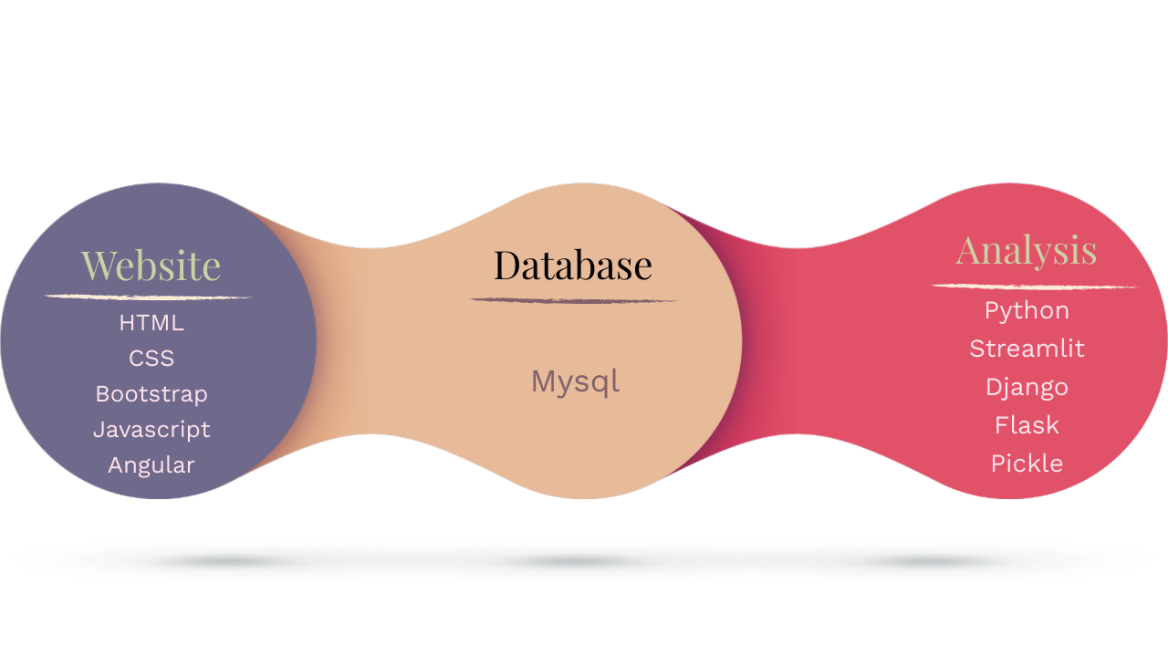
TECHNOLOGIES

Slide 5
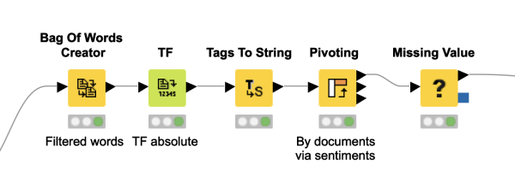
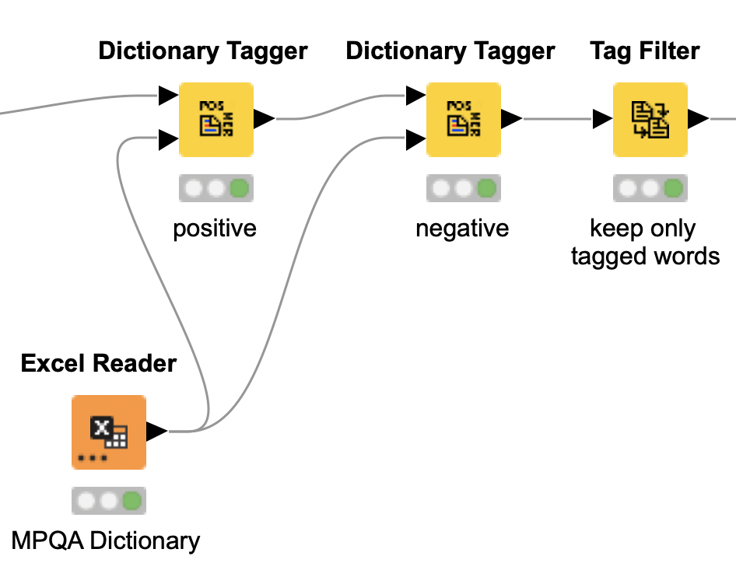
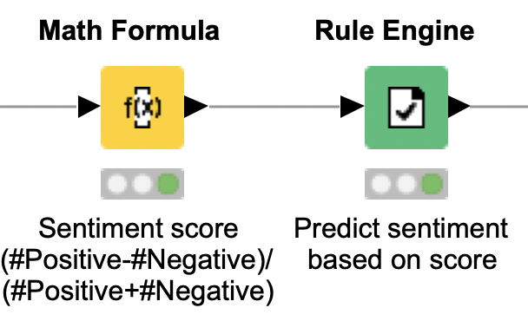
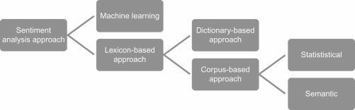
APPROACH
[2]
[3]
Lexicon Based Technique

Slide 6
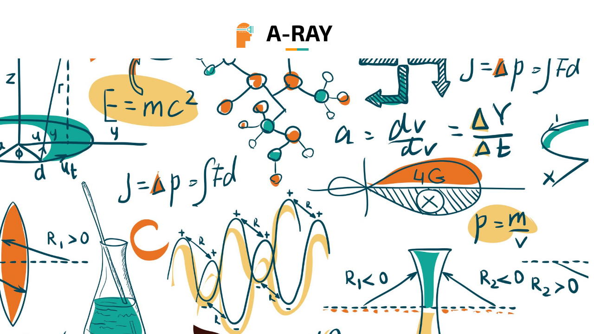
OUTLINE
[1]
Problem Statement
Aims , Objective & Proposed System/Solution​
System Architecture
System Development Approach
Algorithm & Deployment ​
Future Scope​
References​
© Edunet Foundation. All rights reserved.

Slide 7
PROBLEM STATEMENT
The Covid-19 pandemic and the resulting prolonged lockdown have made working and studying from home the new normal.
We are preparing an analysis that will demonstrate the emotional impact of the online system on the lives of students.
[2]
[3]
© Edunet Foundation. All rights reserved.

Slide 8
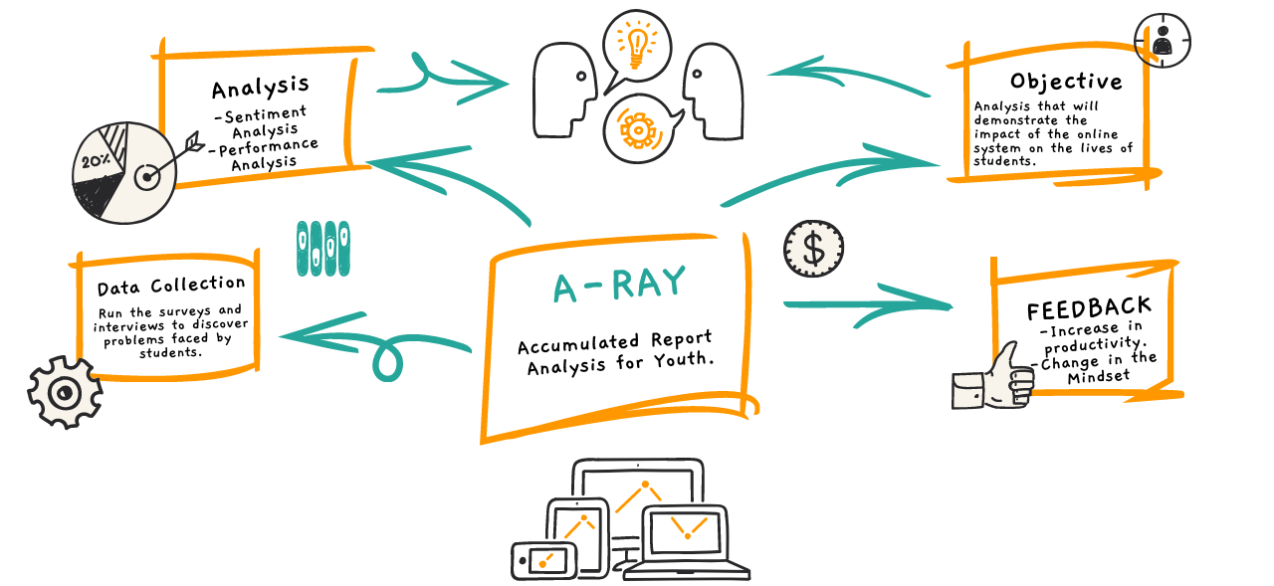
PROPOSED SOLUTION
[4]
© Edunet Foundation. All rights reserved.

Slide 9
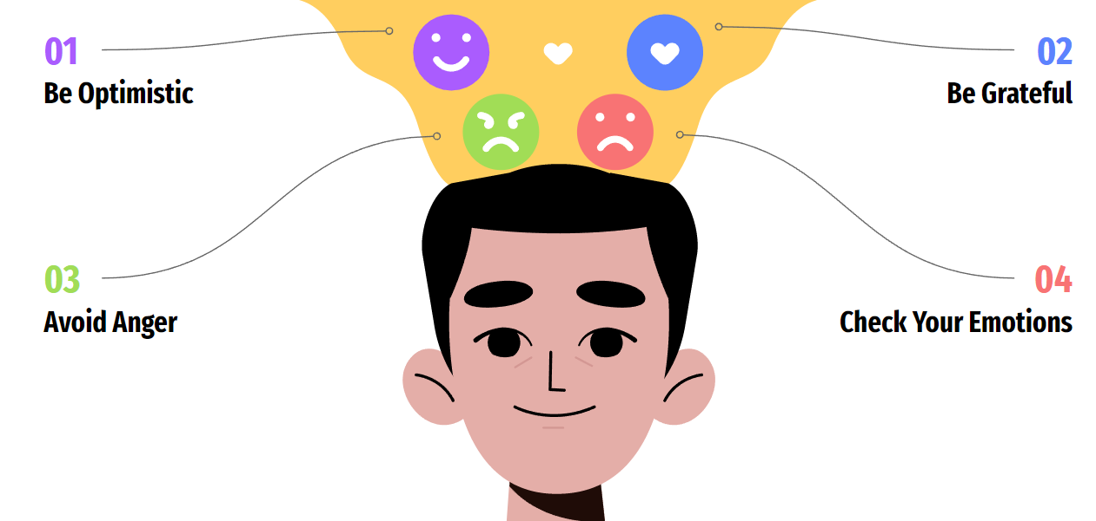
[5]
AFFIRMATIONS AND FEEDBACKS
Self-Management | Stress Management
Self-Awareness | Mindfulness
Social Awareness | Effective Communication
Anxiety Management | Empathy
© Edunet Foundation. All rights reserved.

Slide 10
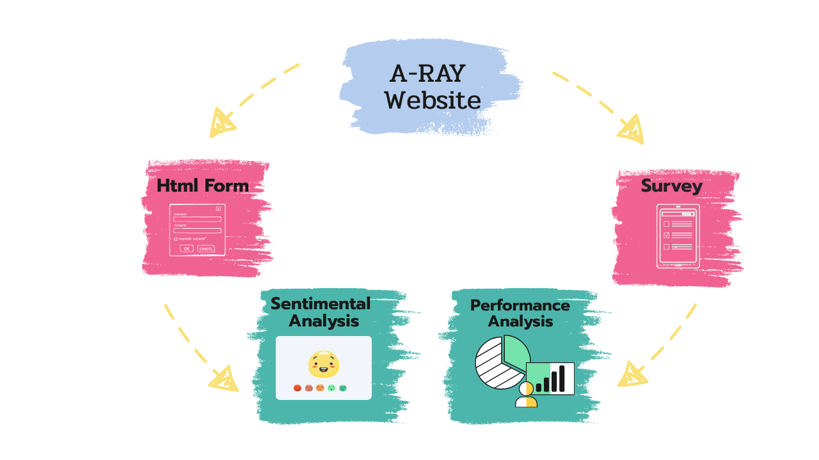
SYSTEM ARCHITECTURE
© Edunet Foundation. All rights reserved.

Slide 11
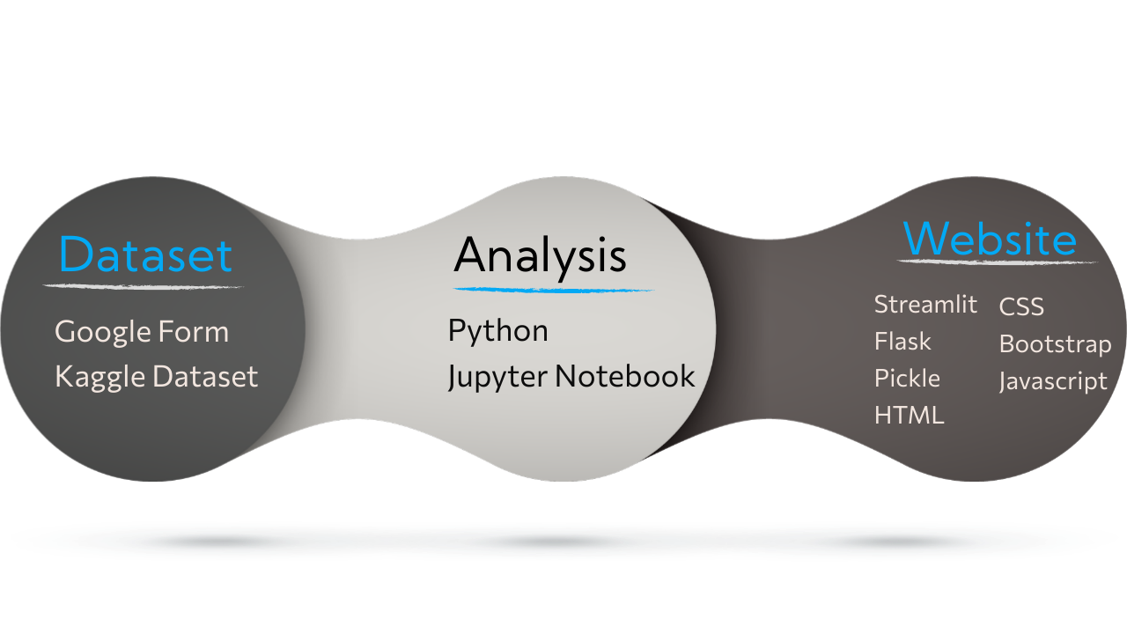
SYSTEM DEVELOPMENT APPROACH
© Edunet Foundation. All rights reserved.

Slide 12
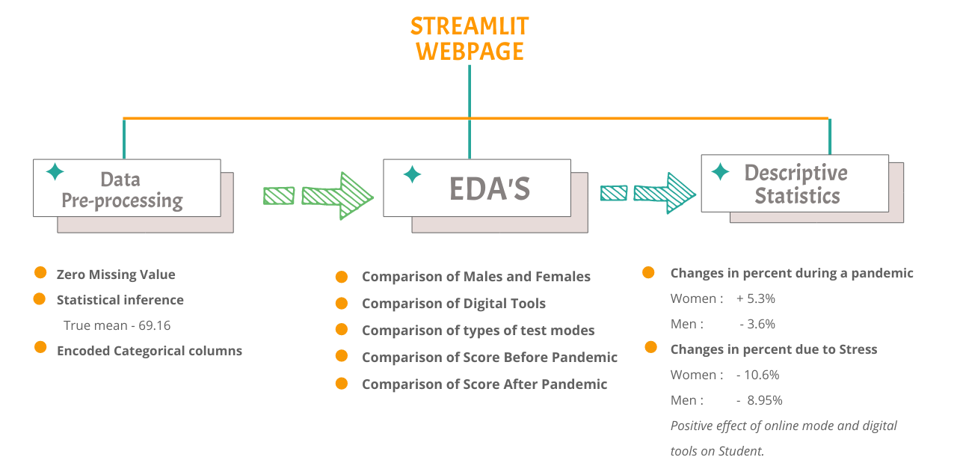
ALGORITHM AND DEPLOYMENT
© Edunet Foundation. All rights reserved.

Slide 13
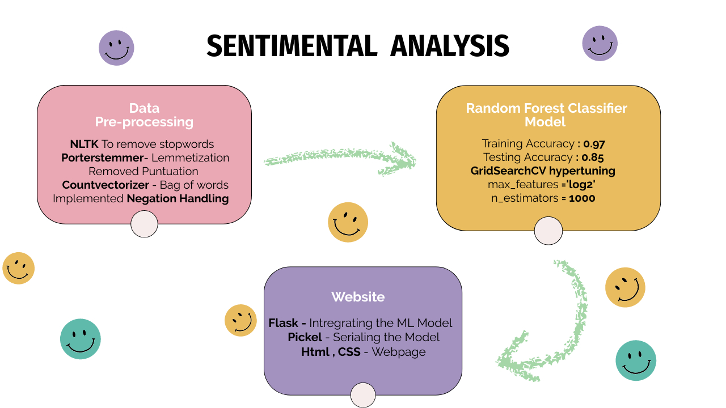
© Edunet Foundation. All rights reserved.

Slide 14

© Edunet Foundation. All rights reserved.

Slide 15
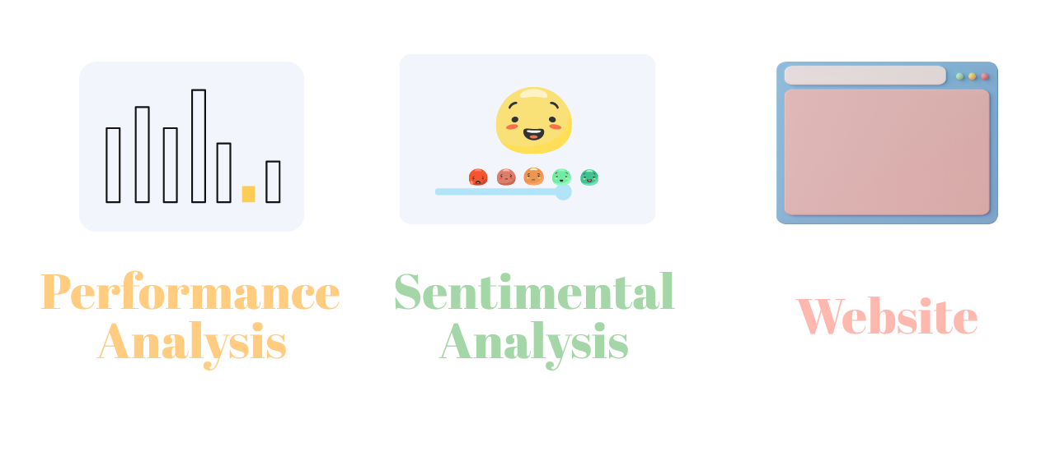
FUTURE SCOPE
© Edunet Foundation. All rights reserved.
© Edunet Foundation. All rights reserved.

Slide 16
THANK YOU
© Edunet Foundation. All rights reserved.

